Slide 1

Understanding Trees in Data Structures
Key concepts and algorithms for tree structures
Notes:
AI-generated content may be incorrect. --- Trees are fundamental data structures that are crucial for various applications in computer science. This presentation will provide an in-depth understanding of trees, binary trees, binary search trees, and advanced tree structures, along with algorithms and practical examples relevant for interviews. Image source: Microsoft brand library

Slide 2

Agenda for Tree Structures
Introduction to Trees
Binary Trees
Binary Search Trees (BST)
Advanced Tree Structures
Common Tree Algorithms
Working Example
Notes:
--- We will begin with an introduction to trees, covering basic definitions and types. Next, we will explore binary trees, their operations, and traversals. After that, we'll dive into binary search trees, advanced tree structures, and common tree algorithms. Finally, we will implement a practical example to solidify our understanding. Image source: Microsoft 365 content library

Slide 3
Introduction to Trees
Notes:
Trees are hierarchical structures that consist of nodes connected by edges. They are widely used in computer science due to their efficiency in organizing and managing data.

Slide 4
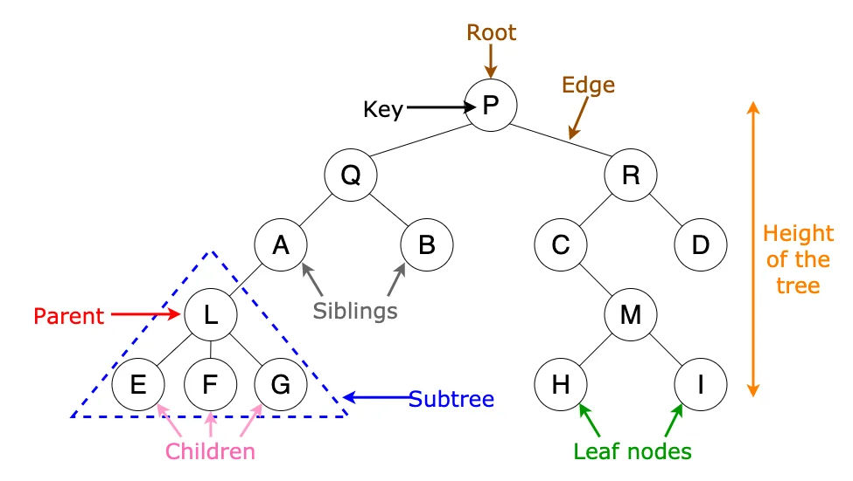
Basic Definitions and Terminology
Definition: A tree is a hierarchical data structure consisting of nodes, with one root node and sub-nodes forming parent-child relationships.
Node Structure: Each node holds data and pointers to its children. Trees can have multiple levels of nested nodes.
Why Trees?: Trees are optimal for representing hierarchical data, supporting efficient insert, search, and delete operations.
Notes:
--- In a tree, each node contains a value and may link to child nodes. The top node is called the root, while nodes without children are leaves. Understanding these terms is fundamental for working with tree structures. Image source: Microsoft 365 content library

Slide 5
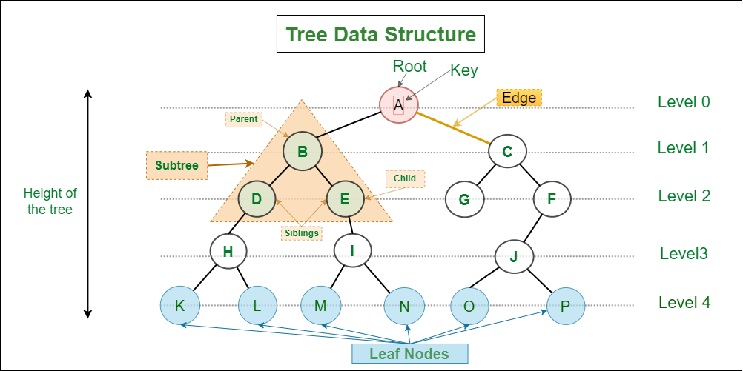
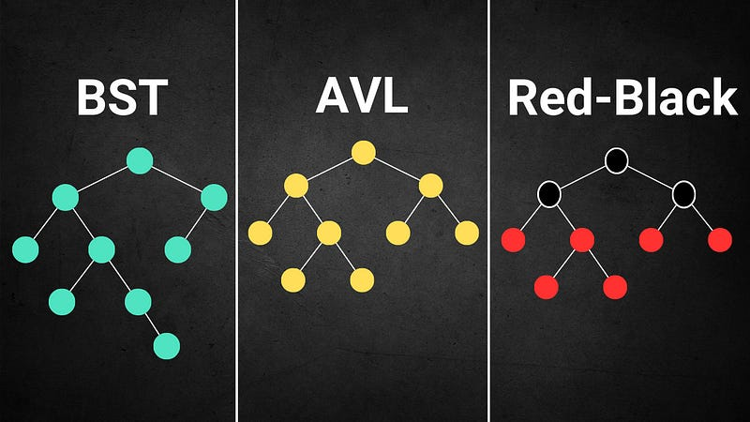
Tree Properties and Types
Properties of Trees
Trees possess various properties such as height, depth, balance, and branching, crucial for understanding their structure.
Types of Trees
There are various types of trees like
Binary trees:
Full Binary Tree: Every node has 0 or 2 children; no node has only one child.
Complete Binary Tree: All levels are filled except possibly the last, which is filled from left to right.
Perfect Binary Tree: All internal nodes have two children and all leaves are at the same level.
Skewed Binary Tree: A degenerate tree where each parent has only one child (left or right).
Binary search trees: a node-based binary tree, left subtree of a node contains only nodes with keys lesser than the node’s key. The right subtree of a node contains only nodes with keys greater than the node’s key. The left and right subtree each must also be a binary search tree.
AVL trees: a self-balancing Binary Search Tree (BST) where the difference between heights of left and right subtrees for any node cannot be more than one.
Red Black trees: a self-balancing binary search tree where each node has a color attribute, either red or black
Notes:
--- Trees have various properties, such as height, depth, and balance. Different types of trees include binary trees, binary search trees, AVL trees, and more, each serving unique purposes. Image source: Microsoft 365 content library

Slide 6

Use Cases and Importance in Computer Science
Hierarchical Data Representation
Trees effectively represent hierarchical data structures such as file systems and organizational charts, allowing for easy navigation.
Role in custom coding
Trees are fundamental in various algorithms, including searching and sorting, enhancing efficiency in data management.
It's widely used in computer networks for storing routing table information.
Decision Trees.
Expression Evaluation.
Database indices
Generative AI:
It is used for indexing and multi-level indexing.
Search Index
Notes:
--- Trees are essential for representing hierarchical data, such as file systems, databases, and more. They play a critical role in algorithms and data management, making them important for technical interviews. Image source: Microsoft brand library

Slide 7
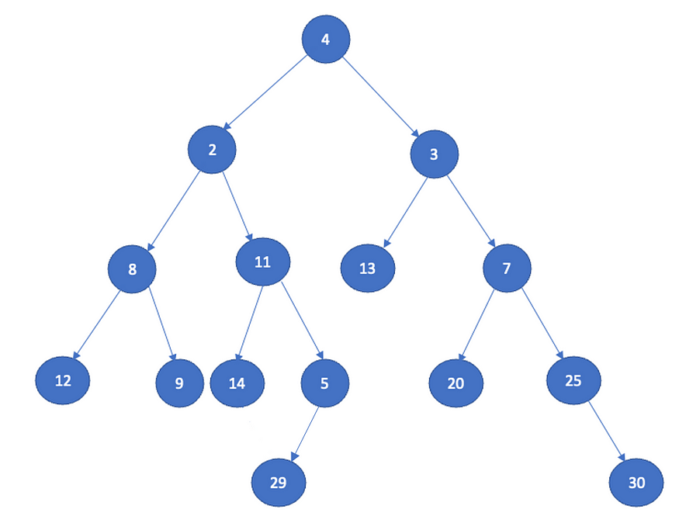
Traversals
Definition of Tree Traversals
Tree traversals are techniques for accessing all nodes in a tree structure systematically.
Inorder Traversal
Inorder traversal visits nodes in a left-root-right order, commonly used in binary search trees.
Inorder traversal of sample tree is 12, 8, 9, 2, 14, 11, 29, 5, 4, 13, 3, 20, 7, 25, 30
Preorder Traversal
Preorder traversal follows a root-left-right order, useful for creating a copy of the tree.
Preorder traversal of above tree is 4, 2, 8, 12, 9, 11, 14, 5, 29, 3, 13, 7, 20, 25, 30
Postorder Traversal
Postorder traversal visits nodes in a left-right-root order, often used for deleting trees.
Postorder traversal of above tree is 12, 9, 8, 14, 29, 5, 11, 2, 13, 20, 30, 25, 7, 3, 4
Notes:
Tree traversals are methods for visiting all nodes in a tree. Inorder, preorder, and postorder traversals each have distinct behaviors and applications in algorithms.

Slide 8




Binary Search Trees – Structure & Operations
Insert: Build BST
Insert 50 → 30 → 70 → 20 → 40 → 60 → 80: each goes left/right recursively based on value.
Search: Find Value
Search 60: 60 < 50? No → 60 > 50 → go right → 60 = 60 → found!
Delete: Node w/ 2 Children
Delete 50 (root): find inorder successor (60), replace, delete successor node.
BST Property
All left descendants < node, all right > node. Enables fast search, O(log n) avg-case.
Notes:
Let’s visualize a common example of building and operating on a Binary Search Tree (BST).
We begin by inserting these values in order: 50, 30, 70, 20, 40, 60, 80. Each value compares to the current node, going left if smaller and right if larger, recursively forming a BST. You’ll end with a balanced tree where each node maintains the BST property.
Searching for 60? Start at 50. Since 60 is greater, move right to 70. Then since 60 < 70, move left to 60. Found in three comparisons—logarithmic efficiency!
Deleting a node with two children—like 50—is the trickiest. We replace it with its inorder successor (60, the smallest node in the right subtree), then delete 60 from its original position.
These operations are core to interviews and competitive coding. Practice them visually and intuitively to master recursion, conditionals, and tree state manipulation.

Slide 9
Advanced Tree Structures
Notes:
In addition to binary trees and BSTs, there are advanced tree structures that offer enhanced functionalities, such as heaps and tries, which are used for specific applications.

Slide 10

Heap: Definition, Types, and Operations
Definition of Heap
A heap is a specialized data structure, providing efficient access to the highest or lowest value.
Types of Heaps
There are two main types of heaps: max heaps that prioritize the largest element, and min heaps that prioritize the smallest element.
Applications of Heaps
Heaps are widely used in priority queues and sorting algorithms, making them a crucial data structure in computer science.
Notes:
A heap is a special type of tree-like structure that follows a specific rule. Think of it as a collection of values arranged in a particular way. In a heap, each value has a relationship with its parent and child nodes.
--- A heap is a specialized tree-based structure that satisfies the heap property. There are two types: max heaps and min heaps, used in priority queues and sorting algorithms.

Slide 11
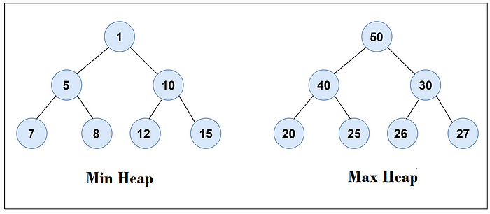




Heaps – Min/Max Structures & Applications
Min Heap Example
Insert: 20 → 15 → 30 → 5; maintain min at root via swaps → 5 becomes root.
Max Heap Example
Insert: 10 → 25 → 15 → 40; largest always percolates to root → 40 becomes root.
Heap Operations
Insert (O(log n)), Extract-Min/Max (O(log n)), Heapify (O(n))
Applications
Used in priority queues, Dijkstra’s shortest path, scheduling systems.
Notes:
Heaps are complete binary trees that follow a strict ordering property: in a min-heap, the root is the smallest element; in a max-heap, the root is the largest. Let’s see this in action with examples.
Insert values 20, 15, 30, and then 5 into a min-heap. After each insertion, we percolate the element up if it's smaller than its parent. By the end, 5 bubbles to the root.
For a max-heap, inserting 10, 25, 15, and then 40 results in 40 climbing up to the root, maintaining the max-first structure.
Common operations include insertions and extractions, both logarithmic in time, and the linear-time heapify function used to build heaps from unsorted arrays. These operations make heaps ideal for implementing priority queues.
Applications are rich—heaps power Dijkstra’s algorithm, job scheduling systems, and median-finding in streams. Understanding the heap property and visualizing swaps is essential to mastering their use.

Slide 12
Common Tree Algorithms
Notes:
Understanding algorithms that operate on trees is essential for optimizing tree operations and solving complex problems. These algorithms enhance the efficiency of tree manipulations.

Slide 13

Depth-First Search (DFS) and Breadth-First Search (BFS)
Fundamental Traversal Algorithms
DFS and BFS are essential algorithms used for traversing tree and graph structures effectively.
Application in Pathfinding
These algorithms are widely used in pathfinding problems, helping to find routes in various applications.
Connectivity Analysis
DFS and BFS are also utilized in analyzing connectivity within networks, determining reachable nodes.
Notes:
--- DFS and BFS are fundamental algorithms for traversing trees and graphs. Each has its advantages for different types of problems, such as pathfinding and connectivity. Image source: Microsoft 365 content library

Slide 14
Working Example
Notes:
To cement our understanding of tree data structures, we will implement a binary search tree in code and demonstrate essential operations.

Slide 15
Problem 1: Recover BST - Two Nodes are Swapped, Correct it
Given a Binary Search Tree (BST) with Two nodes swapped, the task is to recover the original BST.

Slide 16
Problem 2: Lowest Common Ancestor in a Binary Tree
Given the root of a Binary Tree with all unique values and two node values n1 and n2, the task is to find the lowest common ancestor of the given two nodes. The Lowest Common Ancestor (or LCA) is the lowest node in the tree that has both n1 and n2 as descendants. In other words, the LCA of n1 and n2 is the shared ancestor of n1 and n2 that is located farthest from the root.

Slide 17
Practice problems
Problem Link | Complexity
https://leetcode.com/problems/binary-tree-maximum-path-sum | Hard
https://leetcode.com/problems/serialize-and-deserialize-binary-tree | Hard
https://leetcode.com/problems/binary-tree-cameras | Hard
https://leetcode.com/problems/validate-binary-search-tree | Medium
https://leetcode.com/problems/lowest-common-ancestor-of-a-binary-tree | Medium
https://leetcode.com/problems/path-sum-iii | Medium
https://leetcode.com/problems/binary-tree-level-order-traversal | Medium
https://leetcode.com/problems/unique-binary-search-trees | Medium
https://leetcode.com/problems/house-robber-iii | Medium
https://leetcode.com/problems/binary-tree-right-side-view | Medium

Slide 18
Conclusion
Importance of Trees
Understanding tree structures is crucial for various algorithms and data management techniques used in programming.
Technical Interviews
Trees are commonly featured in technical interviews, making it essential to master their operations and applications.
Enhancing Problem-Solving Skills
Mastering tree concepts improves analytical thinking and enhances overall problem-solving abilities in coding tasks.
Notes:
Understanding trees and their operations is essential for technical interviews and real-world applications. Mastering these concepts will enhance your problem-solving skills and prepare you for coding challenges.

